Slide 1
2016 Nonroad Collaborative Work Group
23 May 2019
Local Conference Lines:
Main line: 202-991-0477
EPA Region 1 (Boston): 857-702-8290 EPA Region 2 (NYC): 347-384-7287
EPA Region 3 (Philadelphia): 484-352-3221 EPA Region 4 (Atlanta): 470-705-2279
EPA Region 5 (Chicago): 312-667-7115 EPA Region 6 (Dallas): 469-250-2701
EPA Region 7 (Kansas City): 913-608-8349 EPA Region 8 (Denver): 720-642-6536
EPA Region 9 (San Francisco): 628-246-1294 EPA Region 10 (Seattle): 206-800-4483
EPA RTP (Raleigh): 984-444-7480
Conference ID: 6926578

Slide 2
Meeting Agenda
2016 v1 inventory
2016v1 timeline
State-supplied nonroad data for 2016v1
State-supplied nonroad CDBs for 2017 NEI
For Discussion: national-to-state equipment population allocations
Other business/reminders

Slide 3
2016v1 Timeline
Targeting 2016v1 MOVES-Nonroad run for NEXT MONTH
Will complete 2016v1 runs before 2017 NEI onroad/nonroad
Any last-minute data for inclusion in the v1 nonroad inventory must be supplied by May 31st
The Inventory Collaborative is collecting comments on the beta platform though May 31st: https://forum.cmascenter.org/c/nei-modeling-platform/collaborative-modeling-platform-2016
2016 beta summary files on Google Drive: https://drive.google.com/drive/u/0/folders/1yFEmYlWgcjKkeS48UQ0SerYZdpTY0oEm

Slide 4
State-Supplied Nonroad Data for 2016v1
EPA currently QAing data supplied by States for 2016 platform and 2017 NEI
2016 submissions:
Alaska: zero-out emissions from select sectors (Agricultural, Logging, and Railway Maintenance), due to lack of emissions-generating activity in select counties
Georgia: nonroad fuel supply (nrfuelsupply table) and county allocations (nrstatesurrogate table)

Slide 5
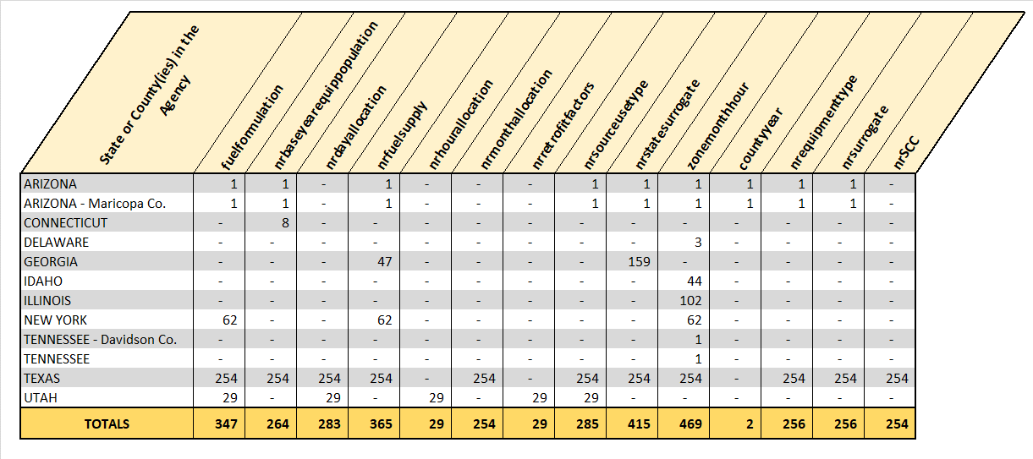
State-Supplied Nonroad CDBs for 2017 NEI
+ Nonroad emissions from California

Slide 6
Nonroad v1 Updates: State-to-County Allocations
Geographic allocation factors for Agricultural and Construction equipment
North Carolina DEQ and EPA OTAQ developed updates to the Construction and Agricultural components of the nrstatesurrogate table
This table allocates equipment from the state- to the county-level, using surrogate data (surrogateID field)
Updated surrogate data:
Construction Sector (surrogateID = 12): acres disturbed by residential, non-residential, and road construction, from 2014 NEI
Agricultural Sector (surrogateID = 11): fuel expenditure data from USDA
Updated nrstatesurrogate table and related notes available on Work Group wiki

Slide 7
Nonroad v1 Discussion: National-to-State Allocations
Equipment populations at the state level are adjusted by modifying the nrbaseyearequippopulation table
This table assigns equipment populations to states for a defined population base year. The model’s current population base years range from 1996-2000 (varies by equipment type).
North Carolina DEQ and EPA have come up with several options for updating the national-to-state allocation of Construction and Agricultural equipment
Adjust each state’s share of the base-year national equipment population total by the state’s share of national acres disturbed by construction activity (Construction equipment) and national fuel expenditure data (Agricultural equipment)
Would essentially be re-allocating current base year equipment populations with surrogate data from 2016
Would not change the population base years, so the model would then just “grow” the re-allocated equipment populations
This adjustment was implemented in OTAQ’s testing run (see March meeting notes on Work Group wiki); see next two slides

Slide 8
Nonroad v1 Discussion: national-to-state allocations
MOVES2014b: total dollar value of construction in 2003 (McGraw-Hill)
2016 Update: acres disturbed by residential, non-residential, and road construction (2014 NEI)

Slide 9
Nonroad v1 Discussion: national-to-state allocations
MOVES2014b: harvested cropland acres in 2002 (USDA)
2016 Update: fuel expenditures for 2012 and 2016 (USDA)

Slide 10
Nonroad v1 Discussion: national-to-state allocations
Replace the existing allocation data (harvested cropland acres and dollar value of construction) with historical fuel expenditures data and acres disturbed by construction activity data to re-allocate the base-year national equipment populations to states
Would essentially be re-allocating current base year equipment populations with surrogate data from the same time period
Would not change the population base years, so the model would then just “grow” the re-allocated equipment populations
Would require compiling historical data (may not be possible for acres disturbed by construction activity data) in order to update the nrbaesyearequippopulation table
Define a new equipment population base year of 2016 for just the Construction and Agricultural sectors, using equipment population output from the 2016 beta run
For every Agricultural and Construction sector sourceTypeID in the nrbaseyearequippopulation table, calculate the portion of the national total that should be assigned to each state by applying the state totals from the surrogate data used for the state-to-county allocation
Similar to option #1, but the model wouldn’t need to “grow” Construction and Agricultural equipment populations from its current (1996-2000) base years

Slide 11
Nonroad v1 Discussion: national-to-state allocations
Summary of options:
Option | Equipment Population Base Year(s), Construction and Agricultural Sectors | National-to-state allocation methodology
#1 | 1996-2000 | Adjust each state’s share of the base-year national equipment population total by the state’s share of national acres disturbed by construction activity (Construction equipment) and national fuel expenditure data (Agricultural equipment)
#2 | 1996-2000 | Replace the existing allocation data (harvested cropland acres and dollar value of construction) with historical fuel expenditures data and acres disturbed by construction activity data, to re-allocate the base-year national equipment populations to states
#3 | 2016 | Start with model-calculated national equipment populations for 2016; apply EPA and NC DEQ state-level allocations

Slide 12
Other Business / Reminders
Questions and Discussion
Reminders:
Comments on beta platform by May 31: https://forum.cmascenter.org/c/nei-modeling-platform/collaborative-modeling-platform-2016
2016 beta summary files on Google Drive: https://drive.google.com/drive/u/0/folders/1yFEmYlWgcjKkeS48UQ0SerYZdpTY0oEm
Work Group meeting minutes and related files and links available on Work Group wiki: http://views.cira.colostate.edu/wiki/wiki/9179
Next meeting: TBD (following v1 run)

